Slide 1
Analyzing Chart-Topping Music
Leveraging Billboard and Spotify Web APIs

Slide 2

Questions to Evaluate:
Is popular music trending more towards
Is popular music getting faster?
Are popular songs getting longer?
Is popular music becoming more explicit?
What trendspopular music would we highlight to music executives looking to publish the next big hit?

Slide 3
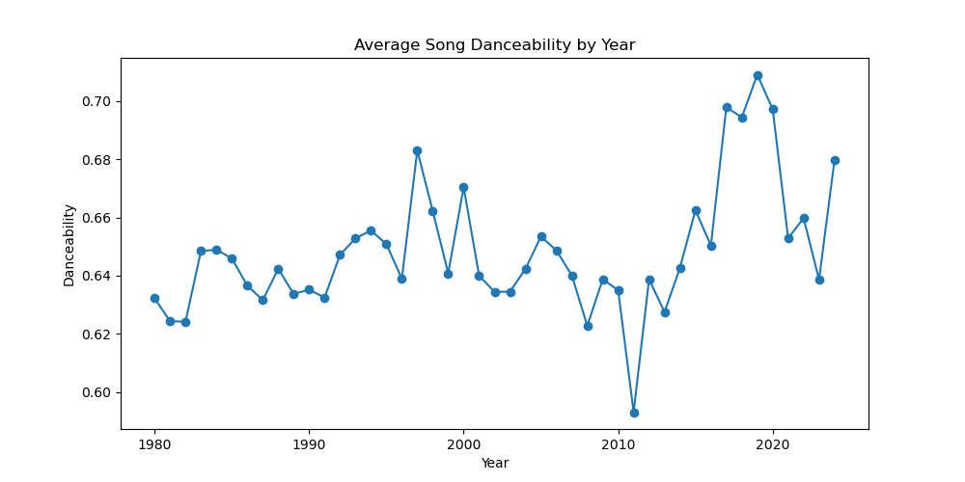
Danceability

Slide 4
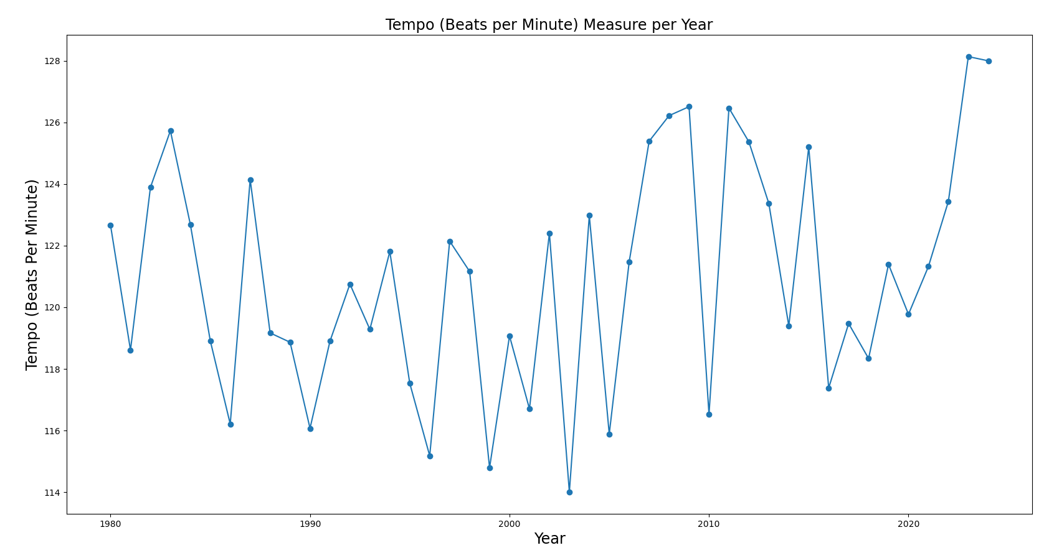
Tempo
Tempo
No apparent trend from beginning of the measurement period to the end (1980 – 2024)
Large variation from year to year

Slide 5
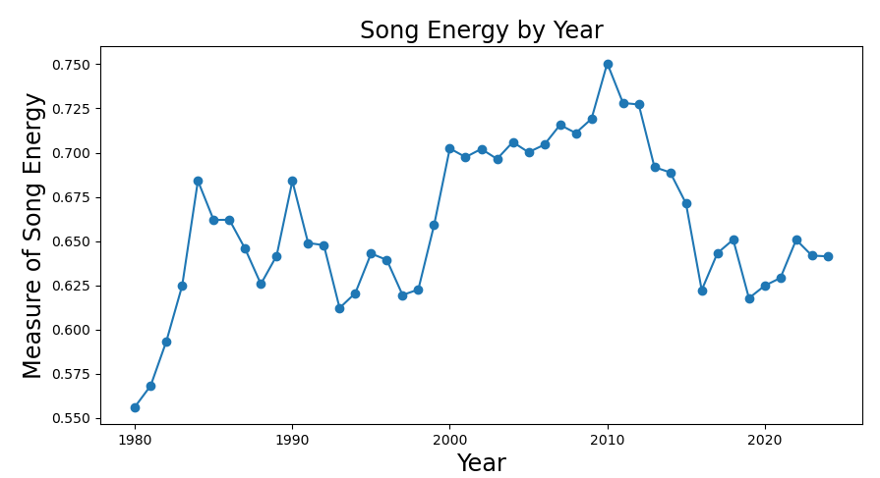
E. nergy
Energy

Slide 6
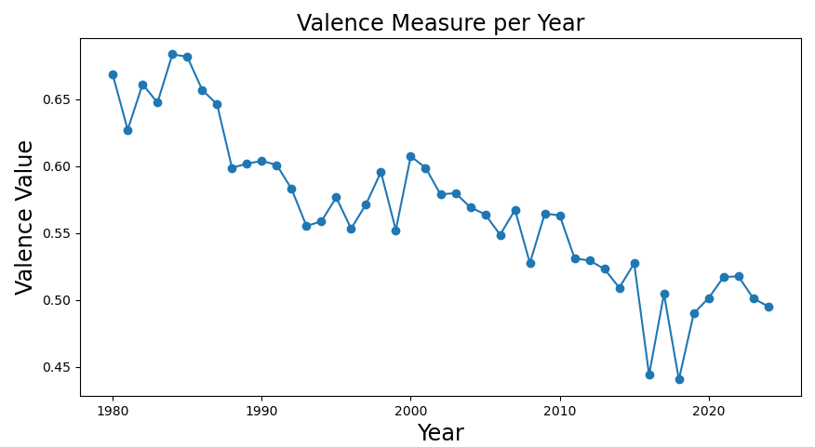
Valence
Valence

Slide 7
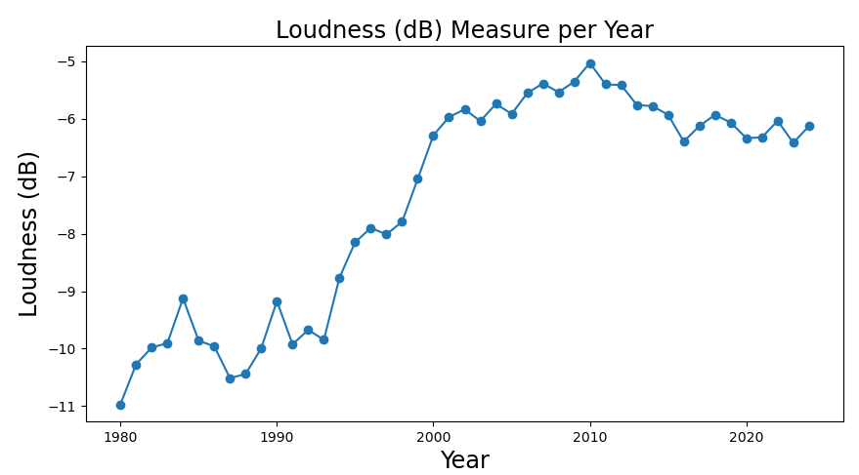
Loudness
General increase in loudness from 1980 to 2024.
Decrease from the peak in 2010, but still maintaining levels well above the first two measurement decades.
Greatest increase in average measured loudness occurred in the 1990s.

Slide 8
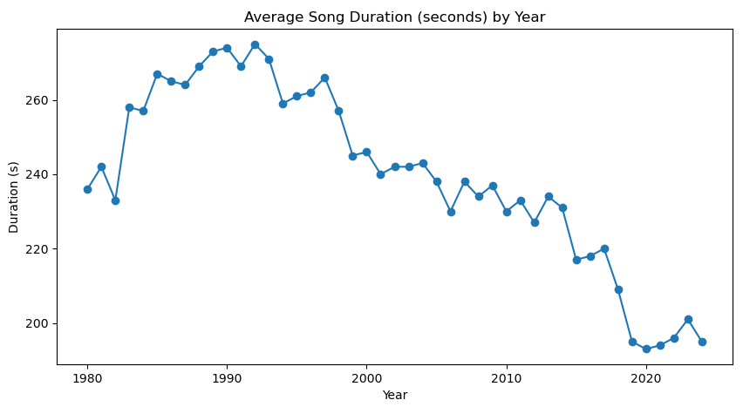
Song Duration

Slide 9
Is popular music getting more or less complex/diverse?

Slide 10
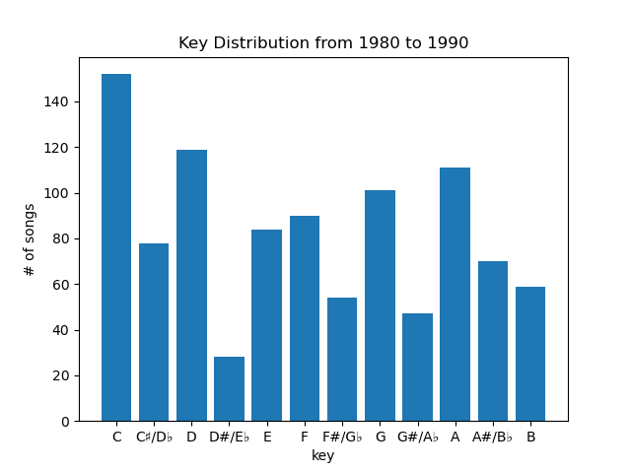
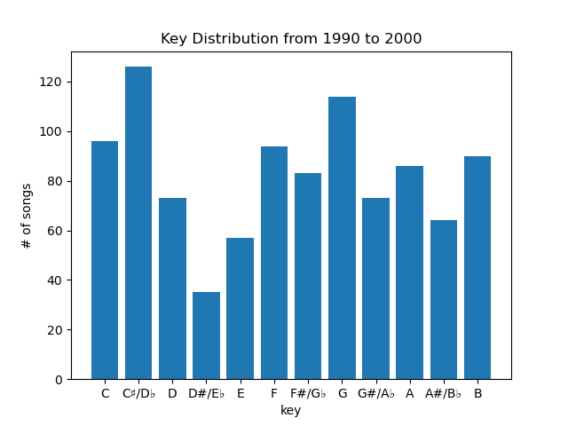
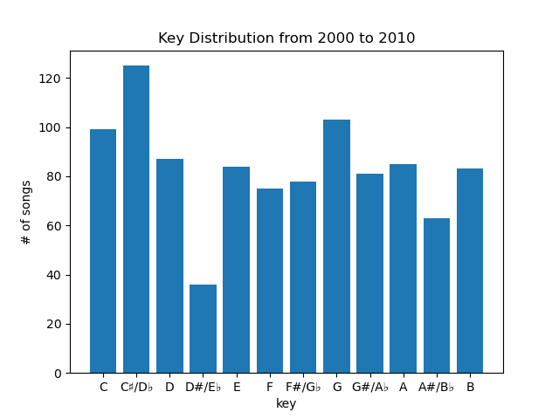
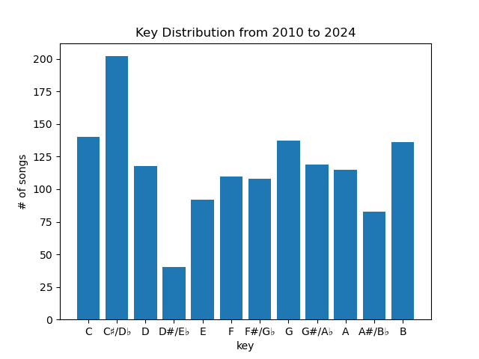
Key Distribution

Slide 11
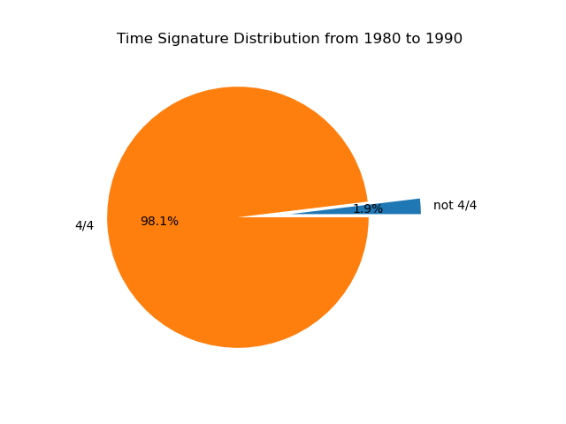
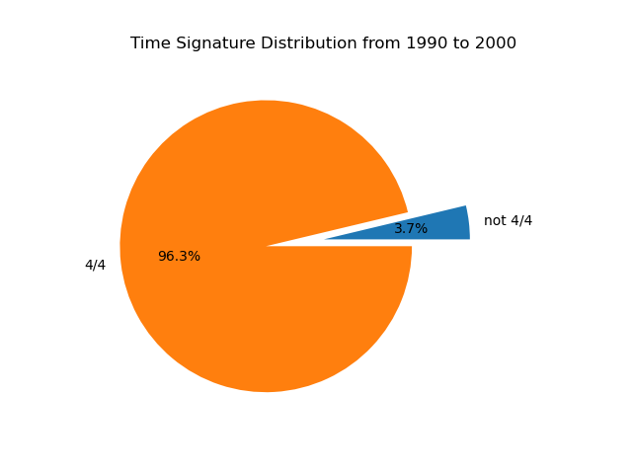
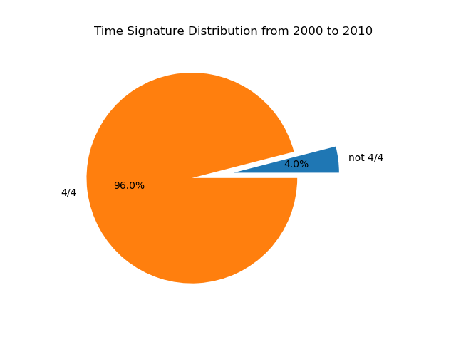
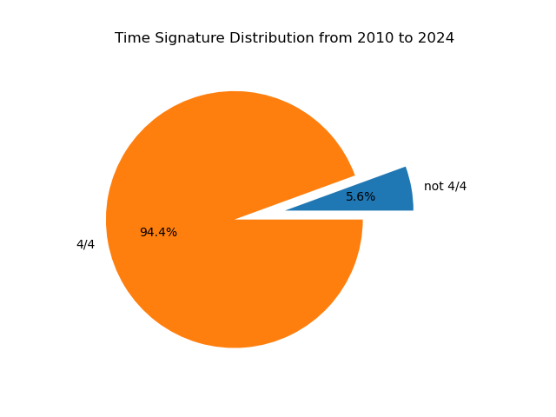
Time Signature

Slide 12
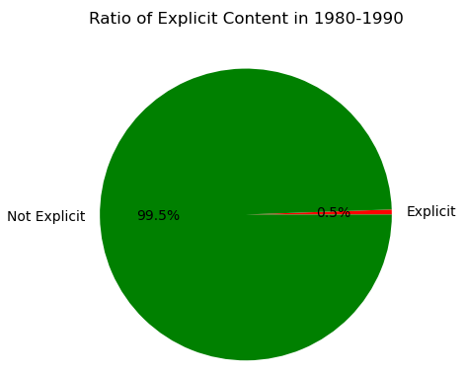
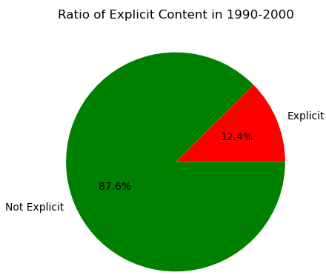
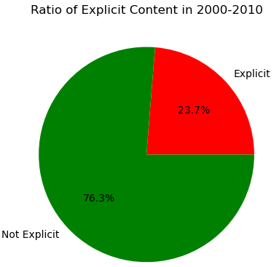
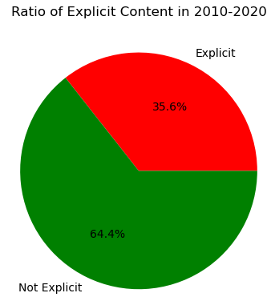
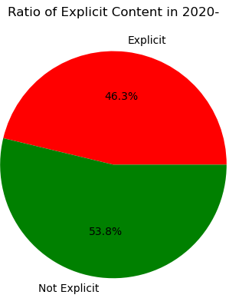
Explicit Content
There is a clear increasing trend in the ratio of explicit content in popular compared to non-explicit content.
Per decade, the ratio of explicit to non-explicit songs has increased by at least 10 percent.
Starting in the 1980s, explicit content in music was extremely uncommon.
By 2020 and onward, explicit songs now constitute nearly half of our sample of popular songs.

